Slide 1
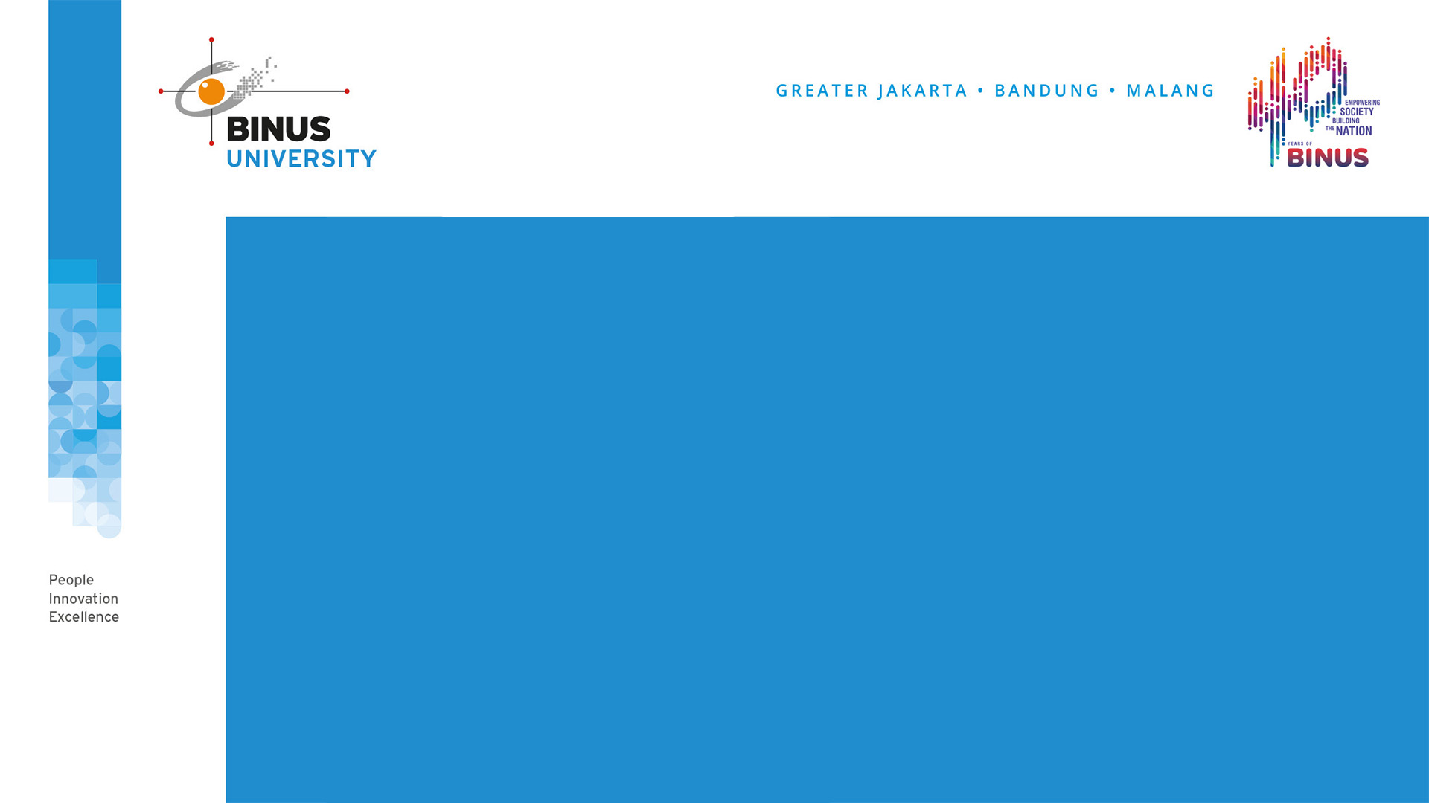
The Unity of Indonesia
SESSION VI
MK CHARACTER PANCASILA

Slide 2

LEARNING OBJECTIVES
By the end of this session, students are expected:
Describe the meaning of multiculturalism and what can we do to apply this paradigm in Indonesia condition;
Able to explain the challenges of multicultural society;
Able to analyze the role of tolerance to create unity in multicultural society.

Slide 3
Definition of Multiculturalism
It derives from 2 words: “multi” and “culturalism”
“multi” means “many” and “culturalism” means “culture ideology”
Multiculturalism means ideology that accommodates many cultural streams or views.
It is all about the acceptance of diversity, and the variety of cultures in our society including, various values, social systems, cultural practices, and customs.
Tolerance and Respect are the keys in the multiculturalism.
When we speak about multiculturalism we must speak about the multicultural society.

Slide 4
Definition of Multicultural Society
Multicultural society refers to a group of societies consisting of many cultural structures.
The characteristics of multicultural society:
Society is segmented into some social groups;
There is a structure difference between one social group to another;
Can be suffered from lack of consensus;
Conflicts tend to happen between the different groups; and political domination.

Slide 5
Indonesia as Multicultural Society
Our society consists of people who come from different backgrounds.
We come from different backgrounds such as, religions, race, and culture.
There are 1.340 tribes in Indonesia with their own uniqueness.
To keep our unity we must make multiculturalism possible to apply.
Why multiculturalism? In multiculturalism we recognize and respect social differences and elements of our cultural background as a gift.

Slide 6
Multicultural Society and Tolerance
Various social groups including indigenous peoples should be viewed as one within the framework of NKRI (unity in diversity).
“Unity in diversity” is only possible if we develop what is called tolerance and respect for the difference.
Tolerance can be viewed as respecting and allowing other people opinions and their choices.
We need to develop a tolerant attitude in everyday life to maintain our unity.

Slide 7
Conslusion
It is impossible for Indonesia people to live without tolerance. Because it is the foundation in order to maintain our unity in diversity. Besides tolerance, each of us always have to have respect for anyone. Respect and tolerance are the main keys in multiculturalism.

Slide 8
Discussion
1. What is the relationship between the unity of Indonesia and our discussion about multiculturalism?
2. What can you do as a student to realize the unity in diversity?

Slide 9


